Slide 1
Let’s Learn a Skill
Theodore Kim
Public Speaking – Demonstrative Speech

Slide 2


Slide 3


Slide 4
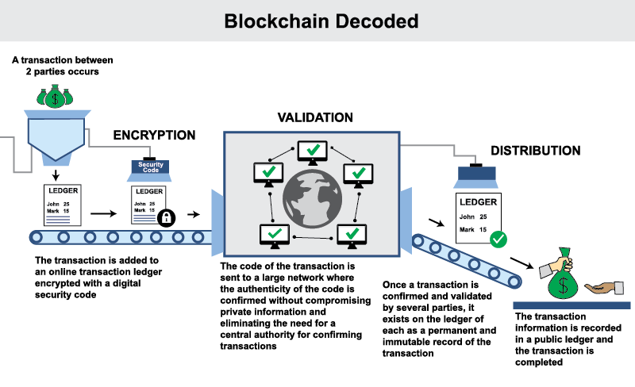

Slide 5
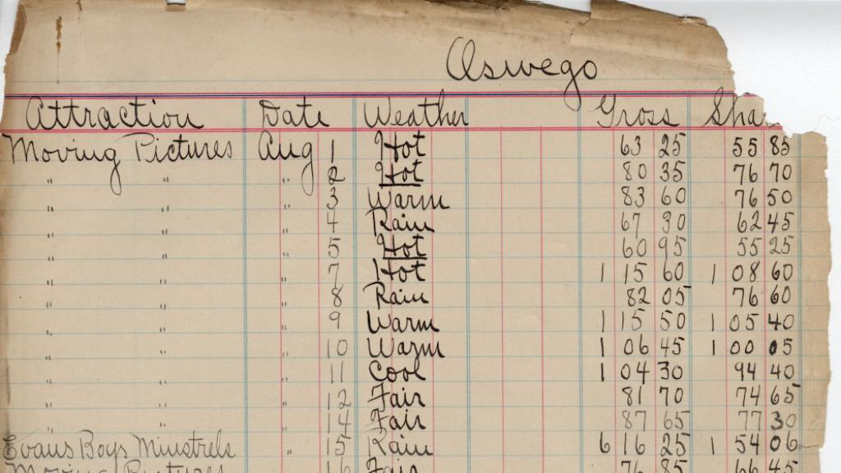

Slide 6


Slide 7


Slide 8
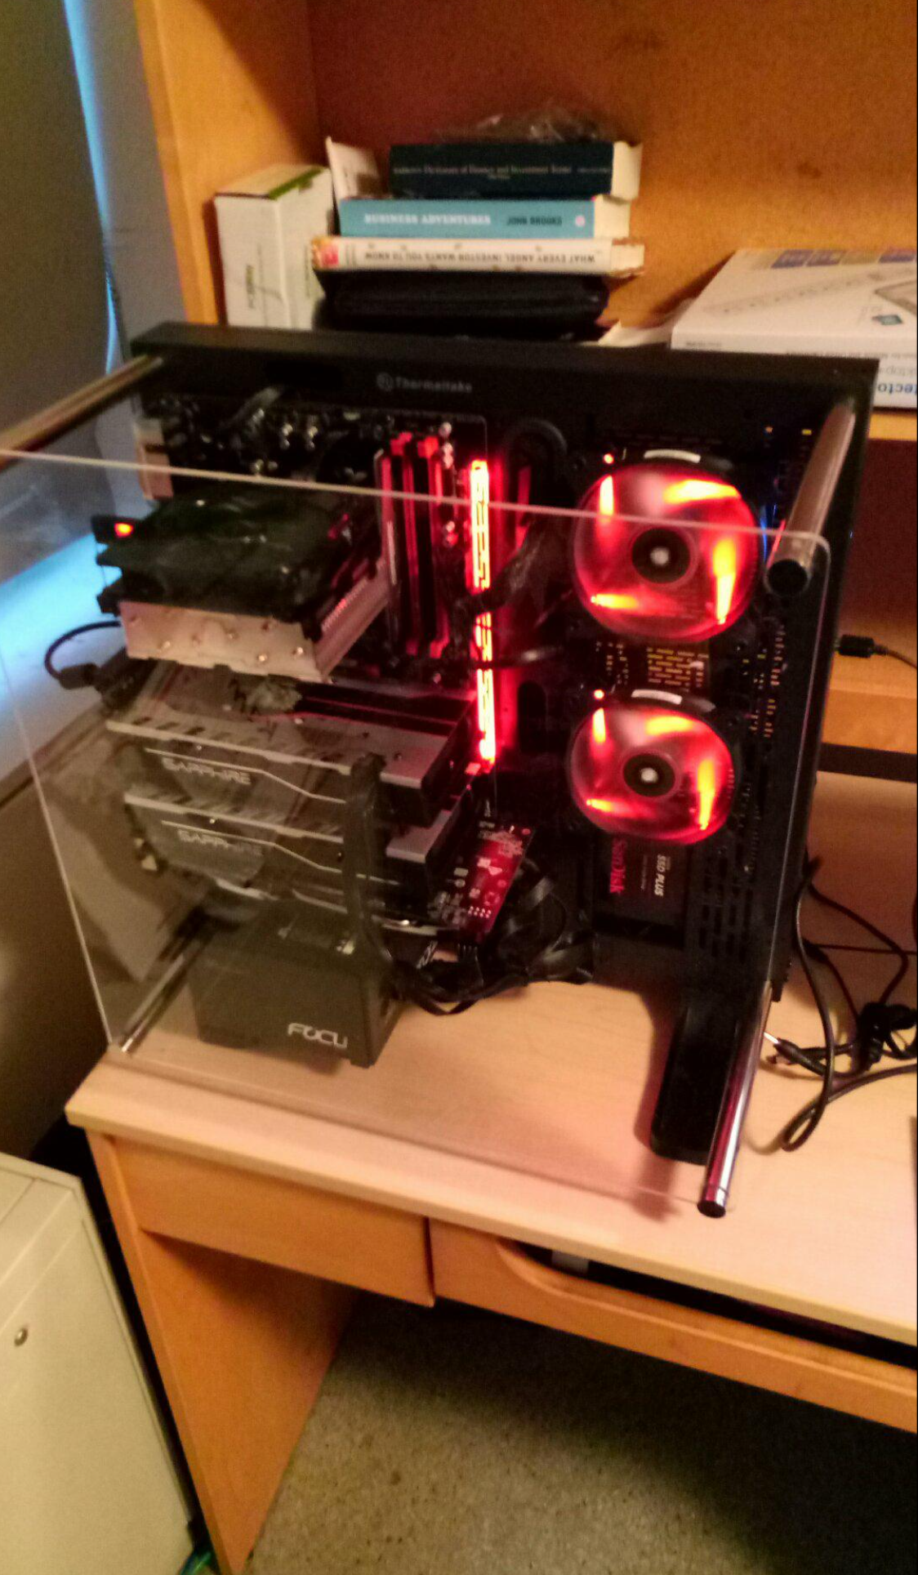

Slide 9
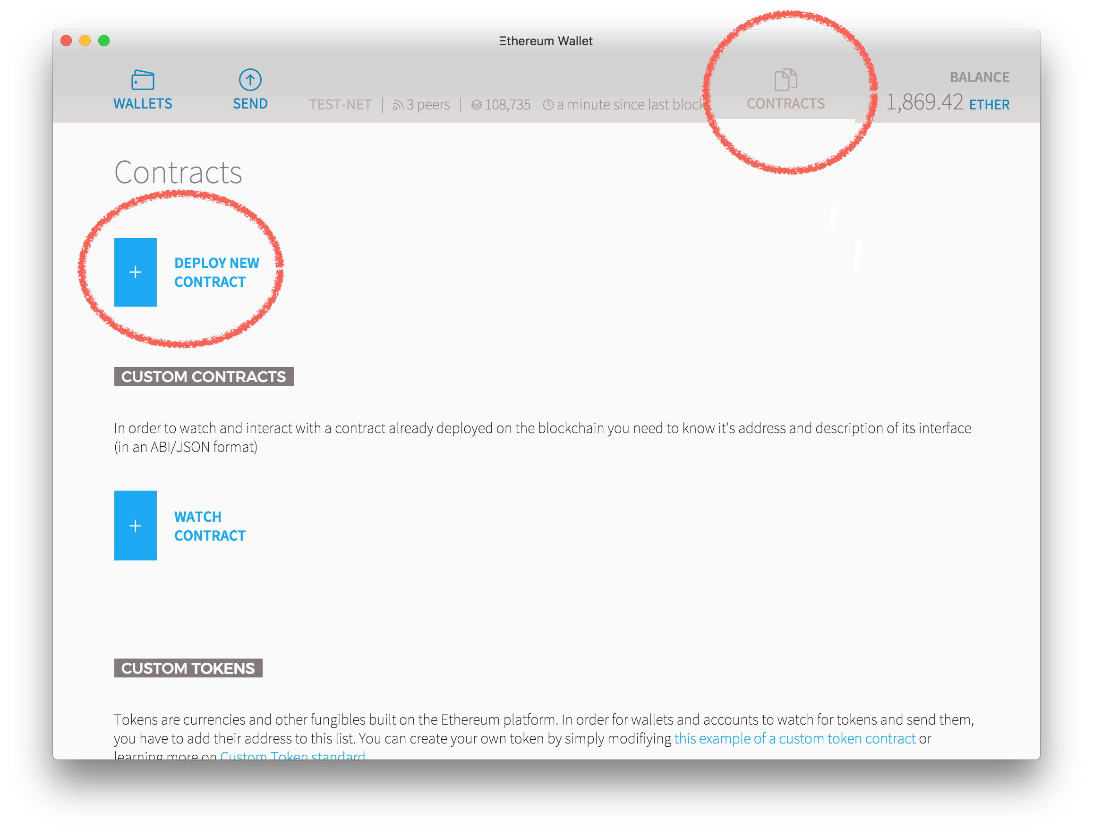

Slide 10
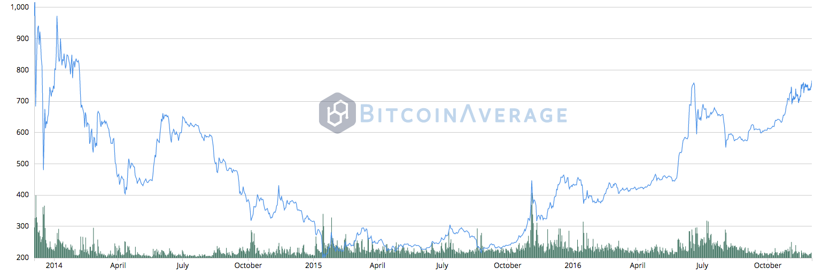

Slide 11
Thank you!
Theodore Kim
Public Speaking – Demonstrative Speech

